Slide 1
GitHub Intro

Slide 2

GitHub Outline
What is?
.gitignore
.gitattributes
README.md
Commits
Commit History
Branches
Pull Requests
Issues

Slide 3
What is GitHub?
Online repository
Free public repositories with unlimited collaborators
Free private repositories with up to three collaborators
Documentation log
Reliable backup
Source code manager
Open source projects
https://github.com/dotnet/core
https://github.com/twbs/bootstrap
https://github.com/tensorflow/tensorflow
https://github.com/angular/angular.js
https://github.com/torvalds/linux

Slide 4
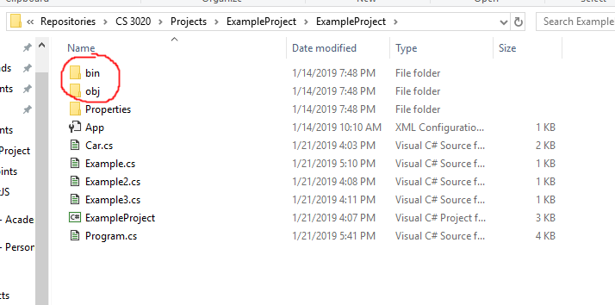
.gitignore
Tells GitHub what files we don’t want to store online.
These folders are useless
But very large!
https://git-scm.com/docs/gitignore

Slide 5
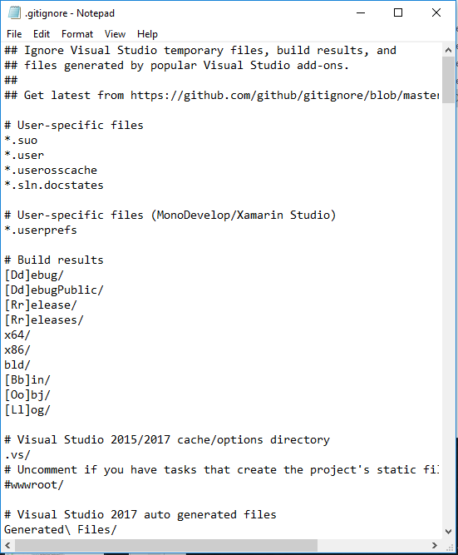
.gitignore
Gitignore.io
Collection of useful .gitignore
# - comment.
These lines are ignored
* - “wildcard” character.
Ignores every character
Can be used before or after text
[Xx] - Either character
Case sensitivity
https://git-scm.com/docs/gitignore

Slide 6
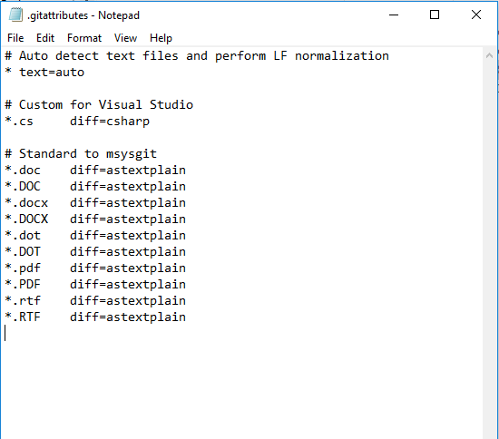
.gitattributes
Tells GitHub how to perceive your files.
Can perform a vast variety of functions.
https://git-scm.com/docs/gitattributes

Slide 7
.gitignore & .gitattributes
Tricky to actually create the files (unless you have git build it for you)
Create a new text file (notepad)
File - Save As
Change “Save as type” to “All Files”
Type just “.gitignore” or “.gitattributes” in the “File Name” field

Slide 8
README.md
Think of it as a “front page” of your repository.
What is this repo
How can I use it
What tools do I need to use it
What frameworks do I need
What plugins do I need
Location of documentation
Maintainers and contributors contact information
If you want your open source project to be successful, think of this as an advertisement.
https://help.github.com/articles/about-readmes/

Slide 9
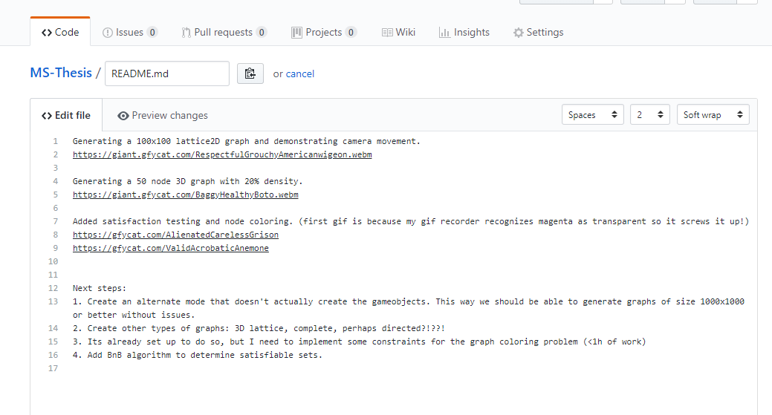
README.md
Edit your readme within GitHub itself.
https://help.github.com/articles/about-readmes/

Slide 10
Commits
When you change your code, you need to “Commit” your changes for them to be available on GitHub.
Local vs Remote
Each commit creates a history node that can be used to trace your code to an earlier date.
Commit right before you make some questionable changes to create an easy restore point.
USE DESCRIPTIVE COMMIT COMMENTS!!!
Knowing what changed and when is incredibly useful for debugging your projects.
Empty or useless commit messages are ill-advised.
Commit code through SourceTree/GitWindows/Terminal

Slide 11
Commit History

Slide 12
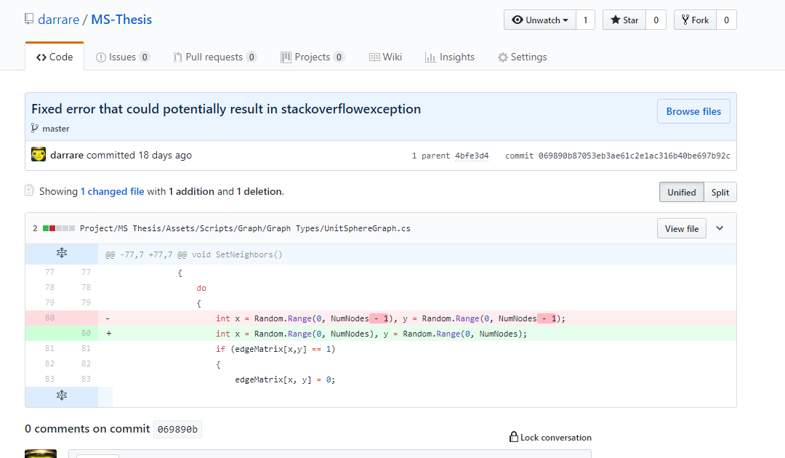
Commit History

Slide 13
Branches
Allows multiple users to work safely on the same repository.
Sometimes a single user might want to make multiple branches for themselves.
Branches can be merged to combine the code between the two.
GitHub is generally smart enough to know what code changed, so that you can easily combine code even in the same file!

Slide 14
Pull Requests
Many repositories only give merge/pull access to certain developers to prevent invalid code from entering their project.
If you want to make a contribution, you will need to make a pull request.
Also useful when working on a team.
Each developer is on their own branch, and submits pull requests into the main branch to have their code verified.
GitHub will automatically compare the current master branch to your pull request and determine if there are any conflicts between them!

Slide 15
Issues
A great place to document problems with the repository.
Being as descriptive as possible is incredibly helpful here! Include images/animations/videos that will help demonstrate your problem.
Often times, when working as a team, you find an issue that you can solve but you know that another team member can solve it with much more precision and speed.
Create an issue and assign them to it

Slide 16
